Slide 1
Non-Metals
CHAPTER 3 Part 2
Notes:
Hi students. In this chapter, we are going to learn all about metals and non-metals.

Slide 2
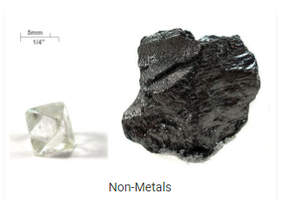
Non-Metals
Non-metals are those which lack all the metallic attributes. They are good insulators of heat and electricity. They are mostly gases and sometimes liquid. Some they are even solid at room temperatures like Carbon, sulfur and phosphorus
Notes:
NON- METALS:
Physical Properties.
They are not ductile.
They are not malleable.
They are not sonorous.
They are bad conductor of heat & electricity
except GRAPHITE (G con. Of elec.).
They are solid,liquid,gas.
They low high density.
They are Brittle and Weak except DIAMOND.
They are not lustrous except IODINE.

Slide 3
Chemical Properties
1. Reaction with water
Non-metal do not react with water but it is usally very reactive in air, which is why some of them are stored in water.
2. Reaction with Acids
None of the non-metals is known to react with acids.
3. Reation with Bases
The reaction between non-metals and bases is a very complex one. The reaction of chlorine with bases like sodium hydroxide gives products like sodium hypochlorite, sodium chloride as well as water.
4. Reaction with Oxygen
Oxides of non-metals are formed when it reacts with oxygen. The oxides of non-metals are acidic or neutral in nature.
Notes:
CHEMICAL PROPERTIES :
Reaction with OXYGEN:
Non-metal + oxygen -> non-metal oxide which can be acid/neutral
Acid oxides are called acid anhydrides
RXN WITH WATER -> NO RXN AT ALL
RXN WITH ACID -> NO RXN AT ALL RXN WITH SALT SOL.
MORE REACTIVE NON METAL DISPLACES LOW REACTIVE FRLM ITS SALT
NaBr+ Cl₂ -> NaCl + Br₂
RXN WITH CHLORINE
FORMS COVALENT CHLORIDE
H₂ + Cl₂ -> HCl
RXN WITH HYDROGEN FORMS COVALENT HYDRIDES
S + H₂ -> H₂S

Slide 4

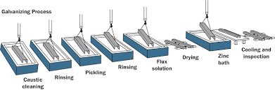
Use Of Metals And Non-Metals
Notes:
USES OF METAL / NON – METALS:
Metal Non-Metals
Cu,Al are used to make wires Hydrogen is used in the hydrogenation of oil to get ghee
Ag,Au for jewelleries Liquid Hydrogen as Rocket Fuel
Zinc for galvanization Carbon in cells
Hg in thermometer Nitrogen in food preservation
Al foil in food packing Sulphur in hardening of rubber
Lead in car batteries Sulphur in match stick
Sulphur in gun powder

Slide 5
Reaction of Metals And Non Metals
Every element wants to become stable and to gain the nearest inert gas electron configuration
Element can become stable by
a)Loosing one or more electron with other atom.
b)Gaining one or more electron with other atom.
c)Sharing one or more electron with other atom.
Notes:
How do metal and non metal react:
Metal + Non- metal → ionic compound
Non metal + Non Metal → covalent compound
Every element wants to become stable and to gain the nearest inert gas electron configuration
Element can become stable by
a)Loosing one or more electron with other atom.
b)Gaining one or more electron with other atom.
c)Sharing one or more electron with other atom.

